Slide 1

Visual Studio 2017
What’s New and C# Improvements
Notes:
But how is it that some companies regularly deliver new features and innovation in the form of software to their customers while other organizations take weeks or months to release software updates?
When we look at the state of software development today, we can see frustration on all sides:
Business, developers and IT all suffer from a lack of collaboration and communication between development and operations in projects
This increases time and labor involved in delivering and maintaining software – not a good thing when fast time to market is key
Add to that the issue that much of the software being built is based on assumptions instead of data and you can see how this can easily lead a team down a wrong path right from the beginning
The inability to deliver software efficiently and react quickly to changes is about more than just frustration …

Slide 2
Bio
Doug Mair
Doug.Mair@gmail.com
@doug_mair
Director of Consulting for Improving Enterprises
Columbus Application Developer User Group – Columbus, Ohio
Third Monday every month at Improving Easton offices.

Slide 3
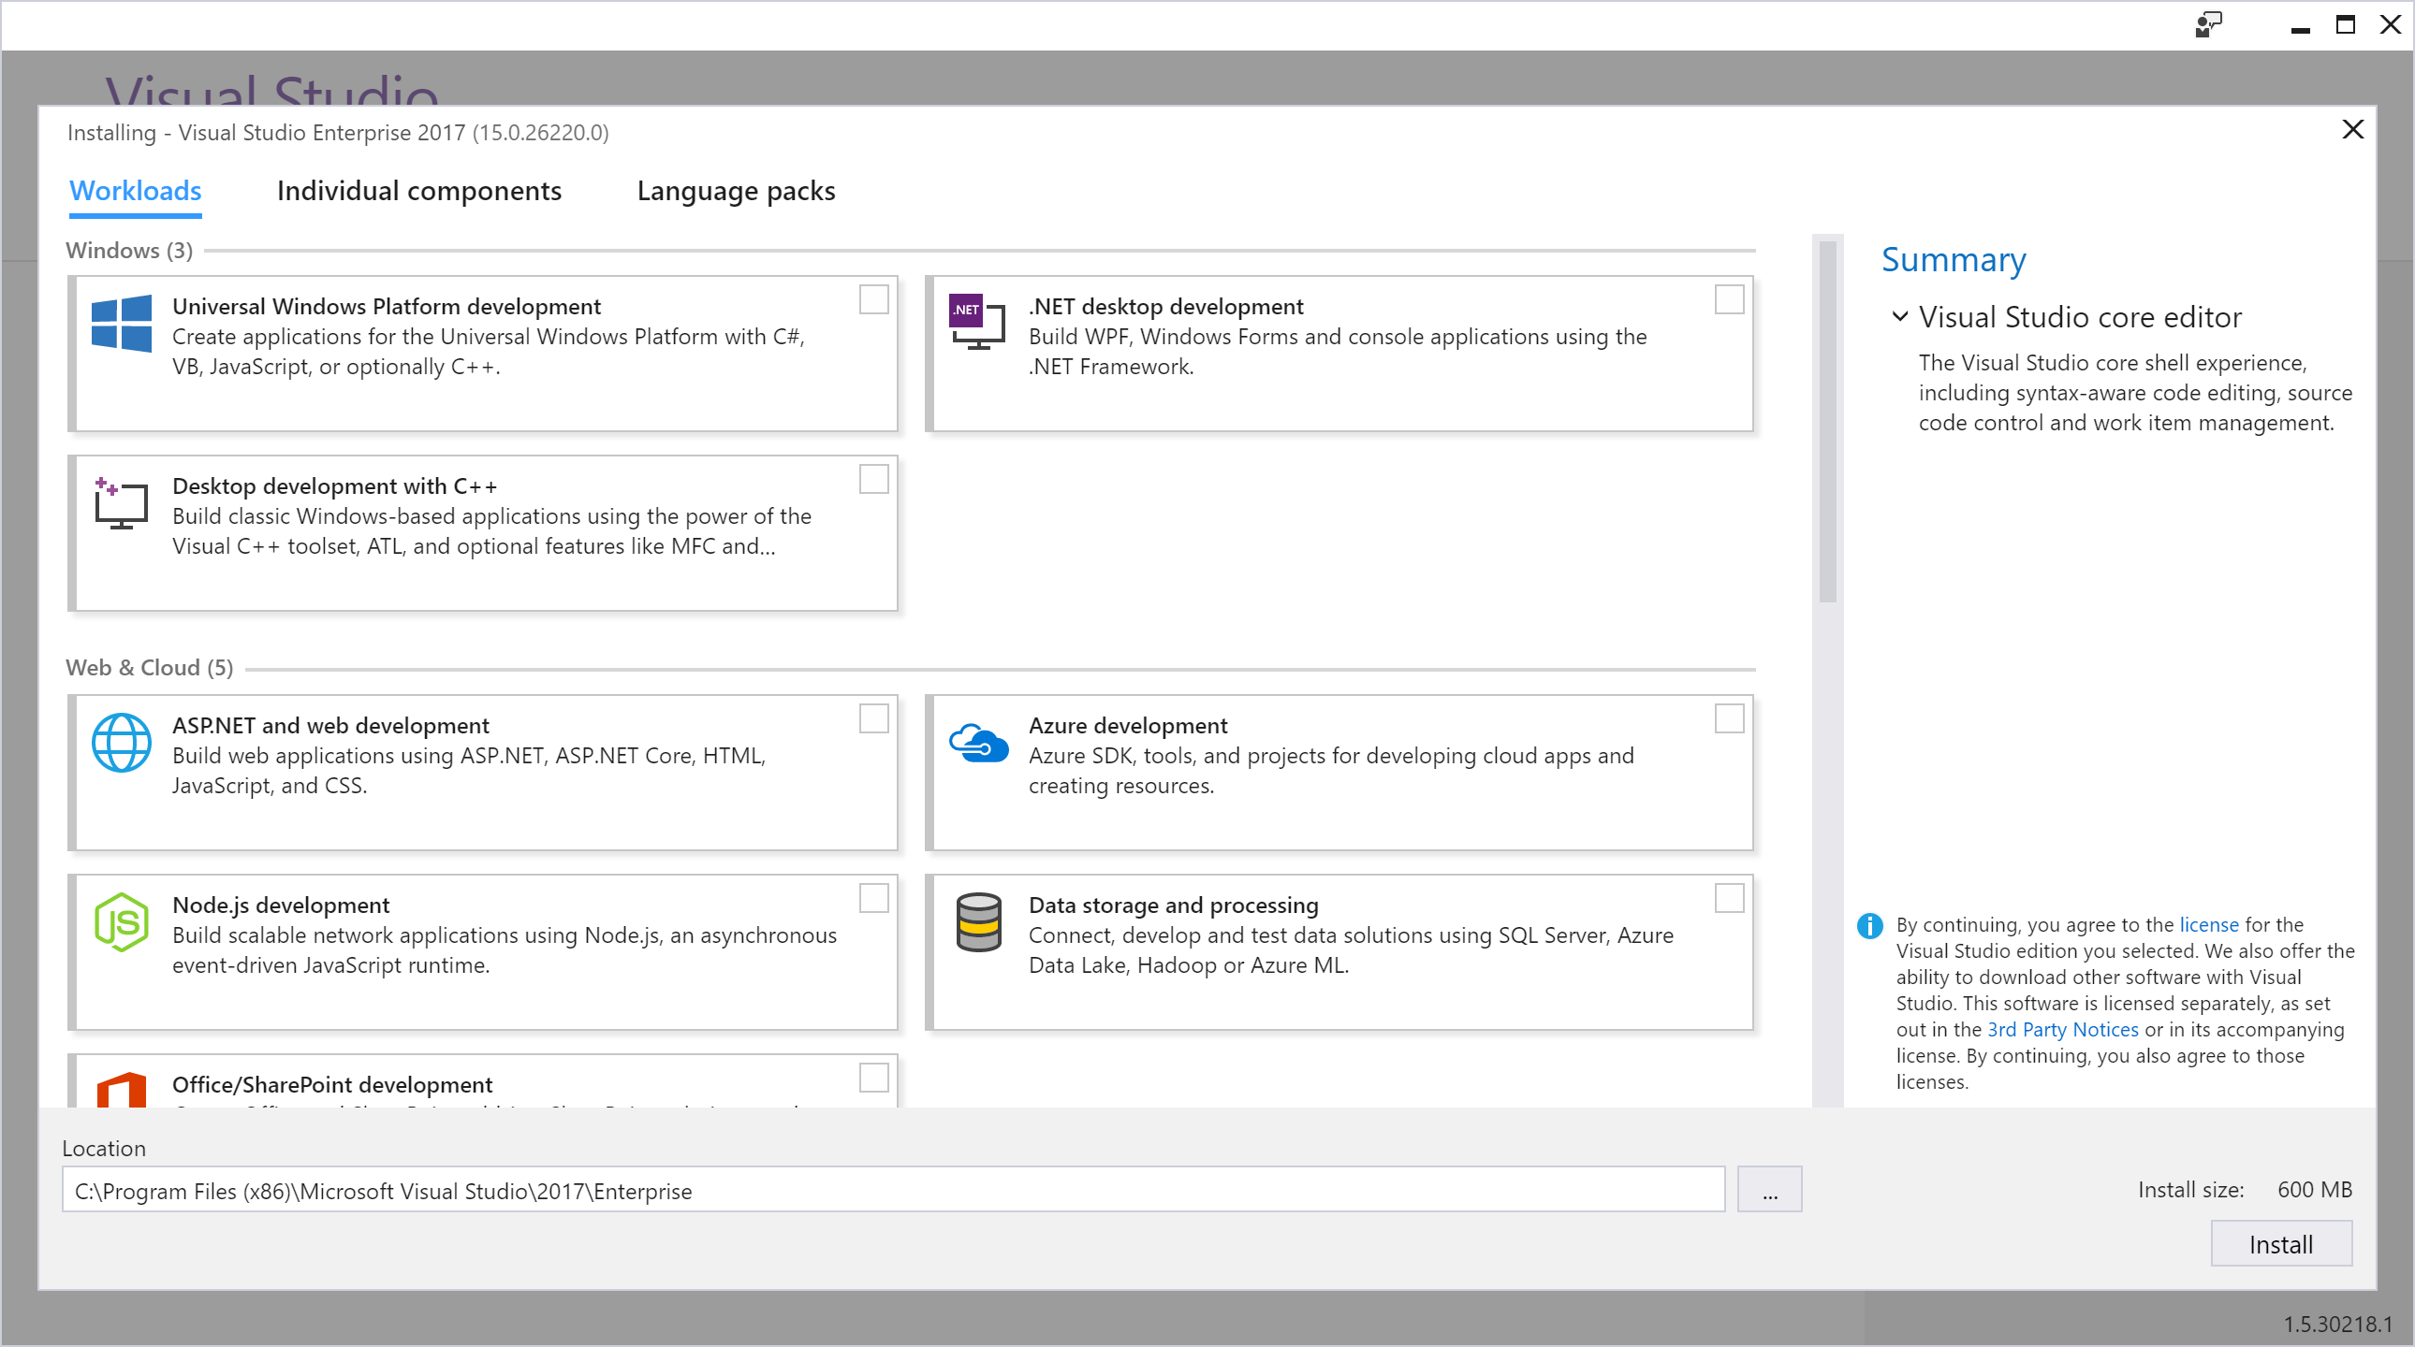
Installation
Notes:
New UI. Not based on a tree of options anymore.
Seems easier to navigate.

Slide 4
Cool Features in VS 2015
Errors and Warnings are now Clickable.
Takes you to Google search.
Scroll Bar Options
Where is Code Lens? (Professional and better).
Productivity Power Tools & Web Essentials

Slide 5
Loads faster.
IDE and Solutions load faster.
Lightweight solution loading
4.5 X Faster than a year ago.

Slide 6
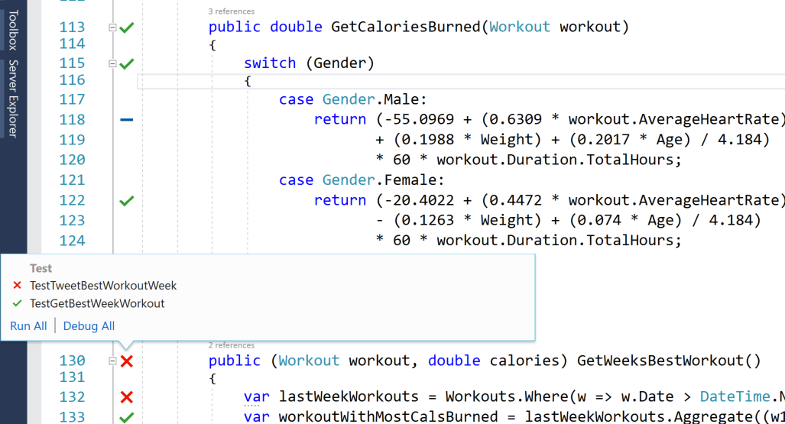
Live unit testing
Enterprise only.
Failing test.
Passing test.
Not covered.
NCrunch is alternative
$159+ per seat
Notes:
$6000 for enterprise.

Slide 7
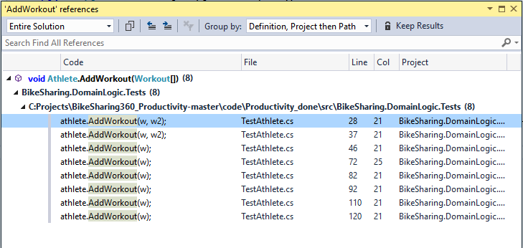
Find All References Dialog (Shift + F12)
Notes:
Find All References
Switch to Athlete.cs method AddWorkout
Press <shift> - F12
Or <Ctrl>-K R
Grouped and highlighted.
Goto Prev and Goto Next

Slide 8
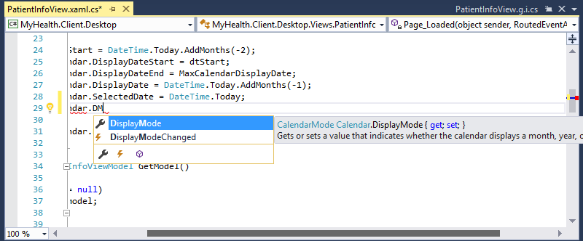
Match highlighting
Notes:
Match Highlighting
Has been there for several versions, maybe back to 2010.
Now it highlights better & more options
Switch to BikeWorkout.cs
Type: var t = AE (ctrl + <space>)
Try with lowercase “ae” to show its not the same.

Slide 9
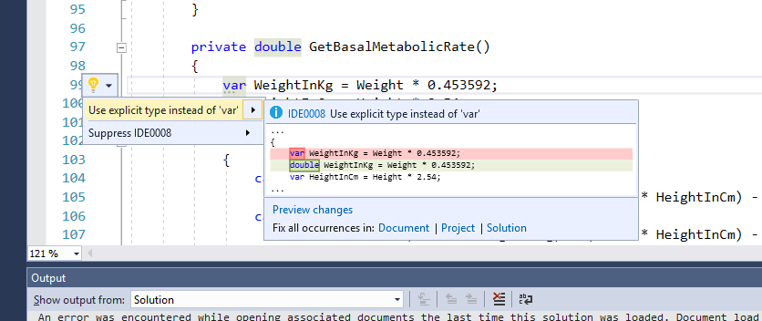
Coding Convention support via .editorconfig
Notes:
Coding Conventions
Notice the … under var and the lightbulb with options.
Expand the options.
Why is VS making this recommendation?

Slide 10
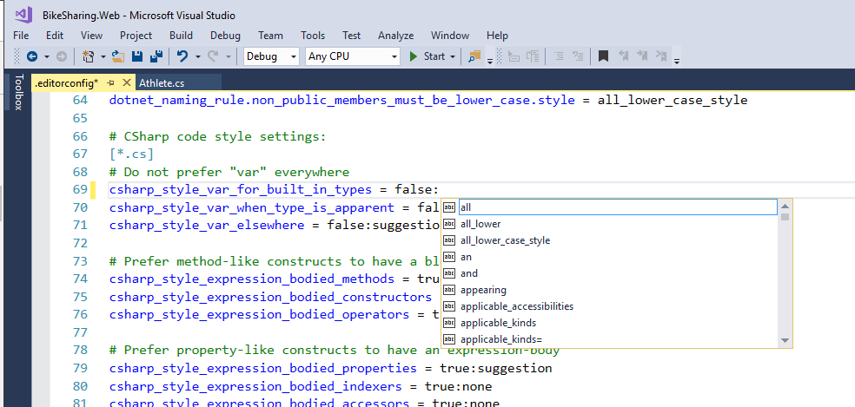
Notes:
The options are customizable based on team preferences.
Open .editorconfig
90 options so far.

Slide 11
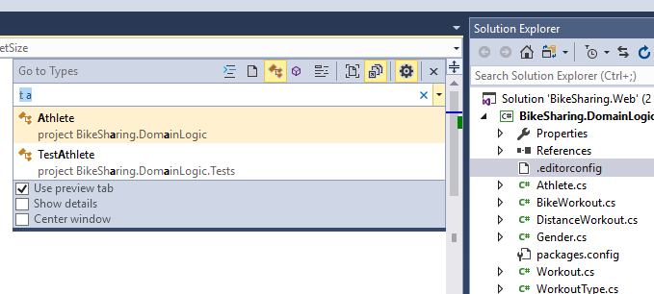
Goto (Ctrl + , or Ctrl+T)
: = Lines
f = files
t = types
m = members
# = symbols
Current file
All files
Notes:
Goto Type
Switch to BikeWorkout.cs type Edit->Goto All or Ctrl + T
This was my favorite feature of Resharper.
Show the scope buttons and the check box options.

Slide 12
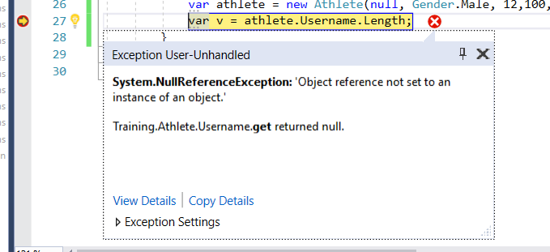
New Exception Helper
Exception unhandled:
Shows which variable caused it.
View Details.
Makes it easier to see
Exception details
Inner exceptions
Notes:
Exception Helper
Swith to TestAthlete.cs, last method.
<Ctrl> - R T
F11 to step into until last line of method.
Exception dialog appears.

Slide 13
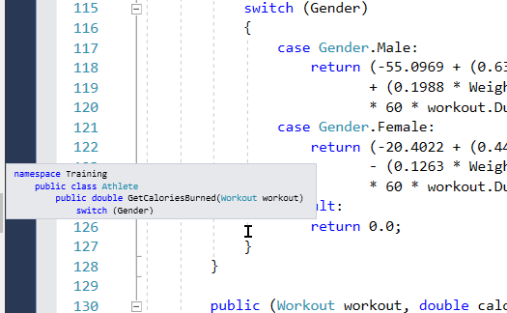
Structure Visualizer
(From Productivity Power Tools)
Hover in scope to see header
Notes:
Show the gird lines.
More collapse points
Switch to Athlete.cs
Hover over a deep scope.
Shows complete context up to namespace.

Slide 14
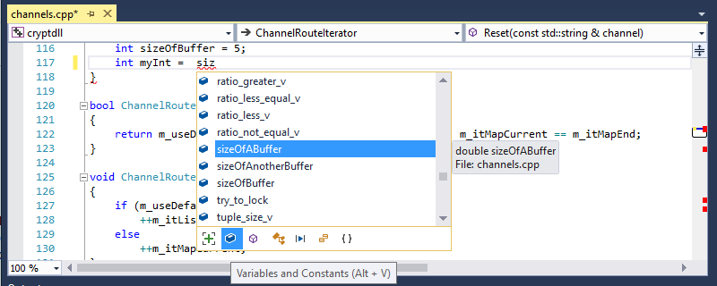
Intellisense filtering
Notes:
Reduces the number of results.
Switch to BikeWorkout.cs
Type: var t = (ctrl + <space>)
Show different filtering options.

Slide 15
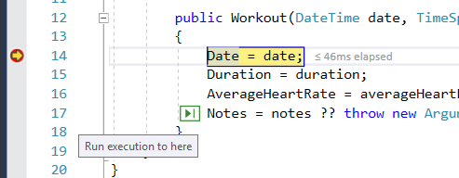
Run to Click - Better run to cursor
Notes:
Can show in the current debug session.

Slide 16
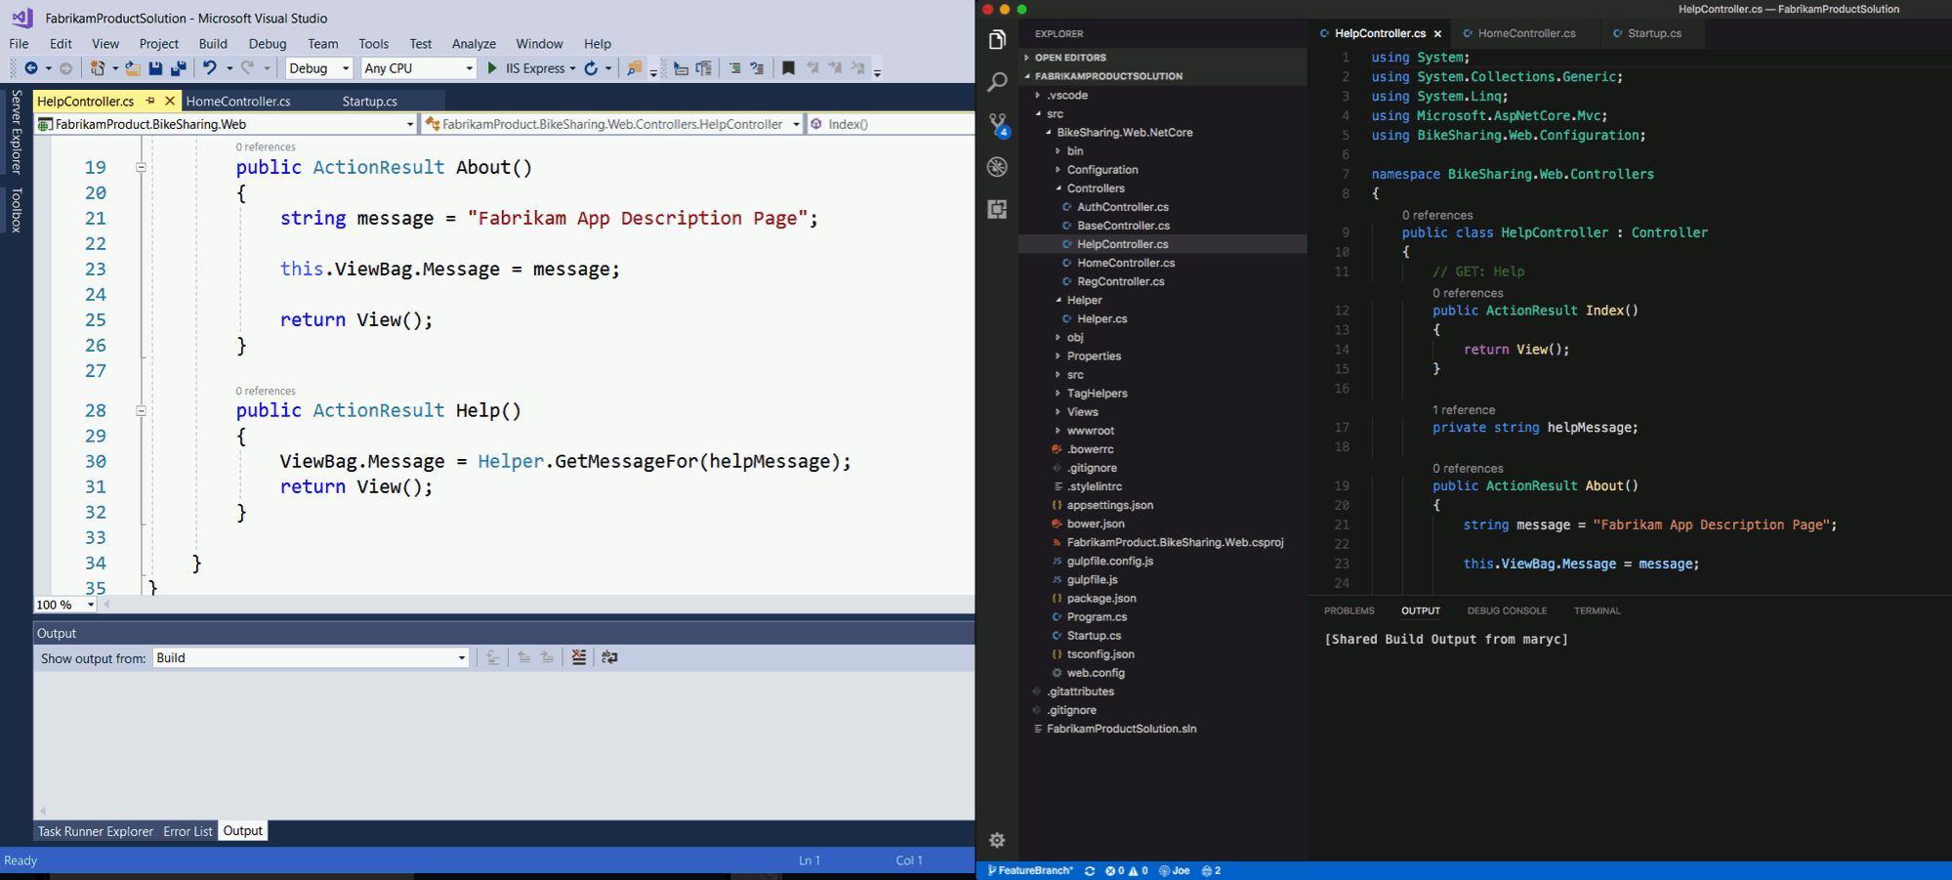
Live Share

Slide 17
Ctrl + . gets smarter.
More Refactorings.
One Click code cleanup - <Ctrl> K D
Add Parameter
Add / Remove Parentheses
Add null check to parameters
Coming soon - Create your own!!
Notes:
Closer to Resharper.

Slide 18
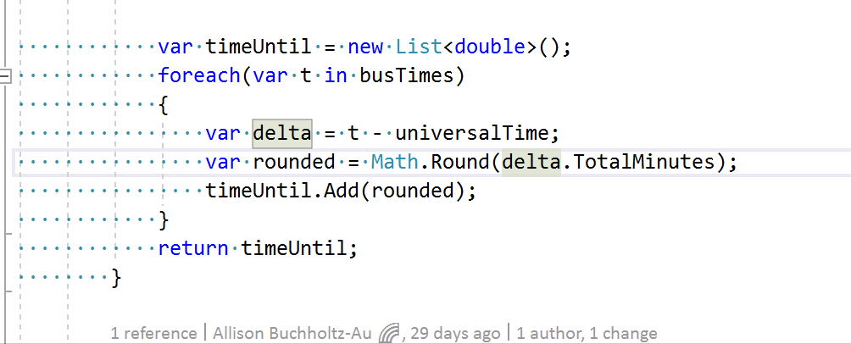
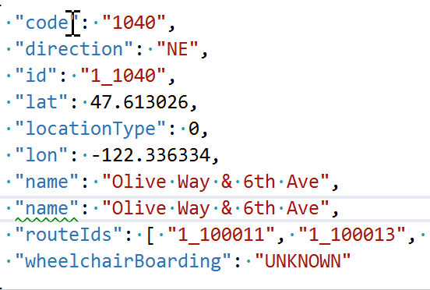
UI Improvements
Press <Ctrl> for GoTo definition
VS Intellicode – Experimental
AI meets Intellisense
Expand selection
<Alt>-<Shift> + & <Alt><Shift> -
Multi Caret Selection
<Alt> <Shift> .
<Ctrl> <Insert> ← Didn’t work for me
<Alt> <Ctrl> click ← Didn’t work for me

Slide 19
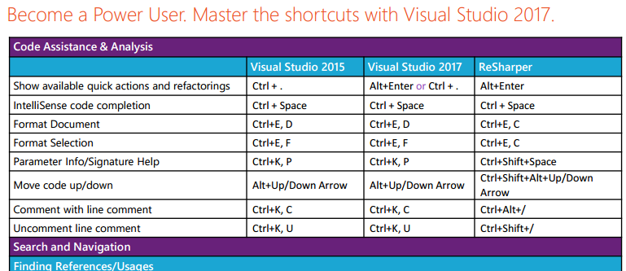
Keyboard shortcuts -
https://aka.ms/vs2017productivityguide
30 + Shortcuts

Slide 20
Microsoft Code Analysis 2017 Extentions
Visual Studio MarketPlace
Microsoft Code Analysis - 100+ FxCop Analyzers
https://marketplace.visualstudio.com/items?itemName=VisualStudioPlatformTeam.MicrosoftCodeAnalysis2017

Slide 21
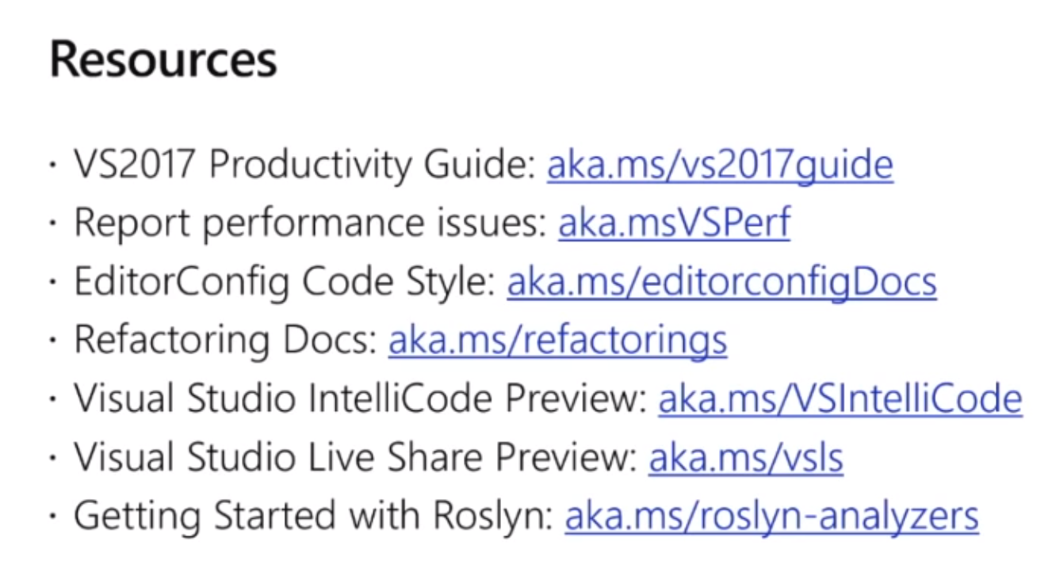

Slide 22
C# 7 features
The features were developed in the open.
C# 7 Announced in 2015.
Not all features from 2015 announcement made it.
Immutable and Record Types may be future.

Slide 23
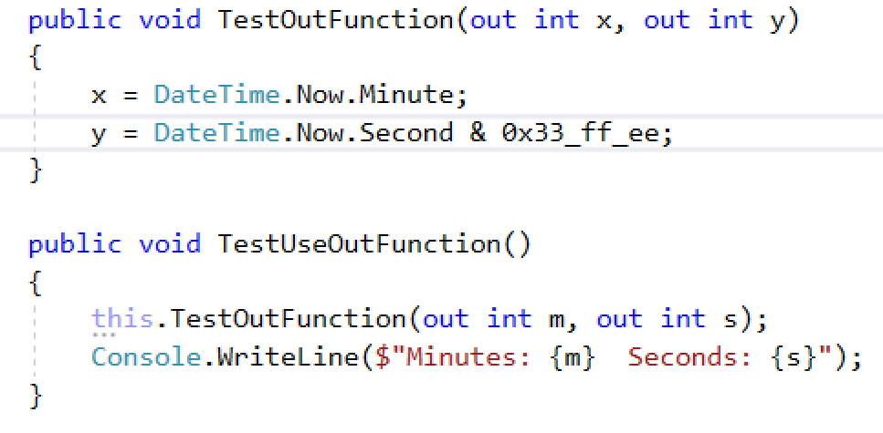
Out Variables
Notes:
Switch to Workout.cs Method TestUseLocalFunction.

Slide 24
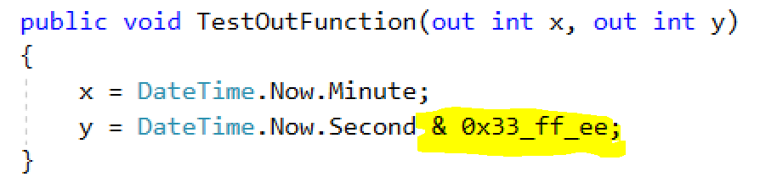
Literal improvements
Notes:
Can have as many underscores as you want.
They are just ignored.
Switch to Workout.cs Method TestUseLocalFunction

Slide 25
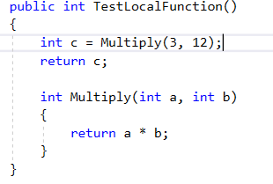
Local functions
Has advantages over Lambdas.
Easier to debug.
Notes:
Switch to BikeWorkout.cs
Method TestLocalFunction()

Slide 26
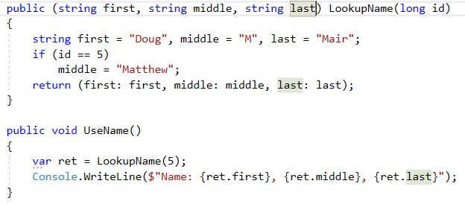
Tuples types
Notes:
Switch to BikeWorkout.cs
Method LookupName and UseName()

Slide 27
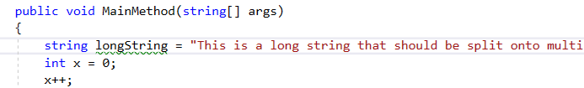
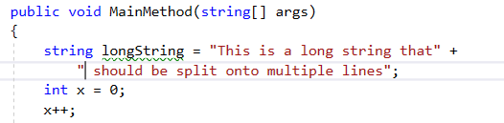
Split long strings by pressing enter.
Just press return where you want the line to split
Notes:
Switch to Workout.cs
Goto MainMethod()
Press return on the long string.

Slide 28
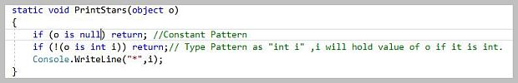
Pattern matching
Will cast object to a type
AND
Introduces variable into scope.
Notes:
No source code example.

Slide 29
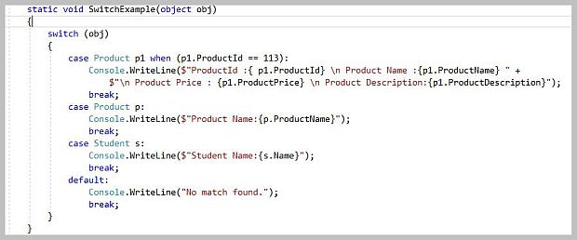
Switch statement and constraints.
If the object can be cast to the given type, that branch will execute.
Notice the constraint on first case.
Order Matters.
Notes:
No source code example.

Slide 30
More New C# Features
7.1
Async Main – Can return Tasks
Default Literal Expressions –
T var = default(t);
Inferred Tuple Element Names –
var coods = (x,y);
Generic Pattern Matching –
case Bow bow:
7.2
Digital Separator after Base Specifier –
var bin = 0b_0000_1111;
private protected
7.3
Performance:
Ref, stackalloc, fixed, span
Tuple Type == or !=
In arguments
8.0
Not Sure yet …
Recursive Pattern Matching
Interface Default Implementations

Slide 31
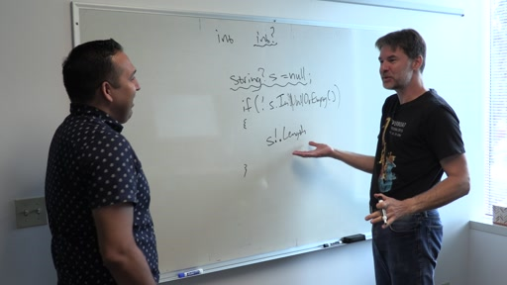
Future: C# 8 Features
1) Strong NULL warnings (Opt in)
2) Async Streams.
Async on the enumerable Next.
3) Interface defaults.
Similar to Java version.
4) Extension everything.
Not just methods.
https://channel9.msdn.com/Blogs/Seth-Juarez/A-Preview-of-C-8-with-Mads-Torgersen?utm_source=t.co&utm_medium=referral

Slide 32
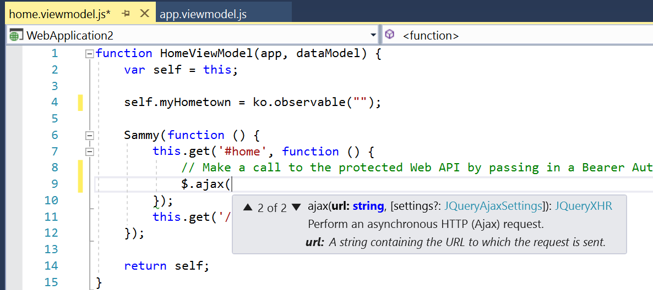
Visual Studio JavaScript Features:
http://blogs.msdn.microsoft.com/visualstudio/2016/11/28/more-productive-javascript-in-visual-studio-2017-rc/
Richer Intellisense
JSDOC Intellisense
ES6 & JSX Syntax
Node.js projects
Web Essentials
Notes:
Mads Christensen

Slide 33

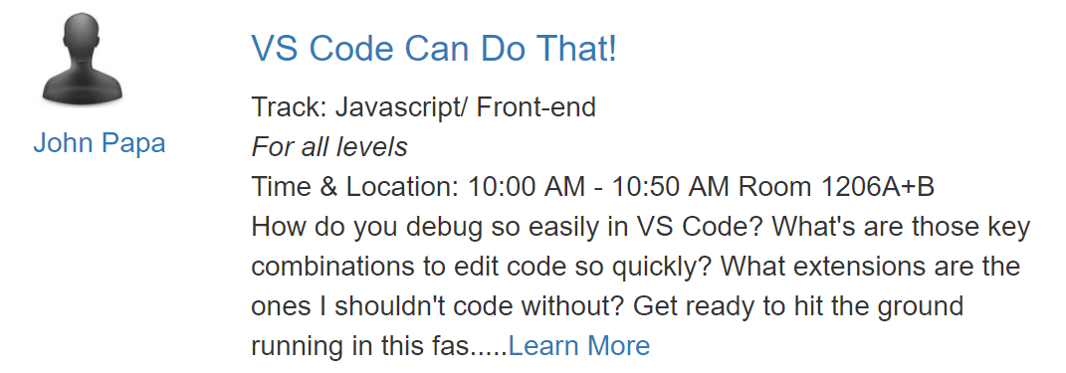
VS Code
Continually improving
Excellent Chrome Browser and Debugger integration.
Session:
Notes:
Upcoming Pluralsight course.
VS Code / Angular

Slide 34
Thanks for listening.
@doug_mair
Doug.Mair@gmail.com

